Slide 1
Wave Interactions

Slide 2
Interference of Waves:
Principle of superposition: at any point the amplitude of two interfering waves is the sum of the amplitudes of the individual
waves

Slide 3
Constructive interference: the process
of forming a wave with a larger amplitude when two or more waves combine.
1
2
3
4
5

Slide 4
Destructive interference: the process of
forming a wave with a smaller amplitude
when two or more waves combine
1
2
3
4
5

Slide 5

Example:
Draw the resultant wave that would be heard if pulses A and B are moving as shown in Fig.
Step 1: On graph paper, draw the two waveforms, exactly as shown in Figure, but with one over the other.
Step2: For each segment of the graph paper, add the amplitudes of the top and the bottom waveforms. Use negative numbers for the bottom waveform.
Step 3: Draw the resultant waveform

Slide 6
Example:
Use the principle of superposition to determine the resulting waveform when the waves in Figure interfere with each other.

Slide 7
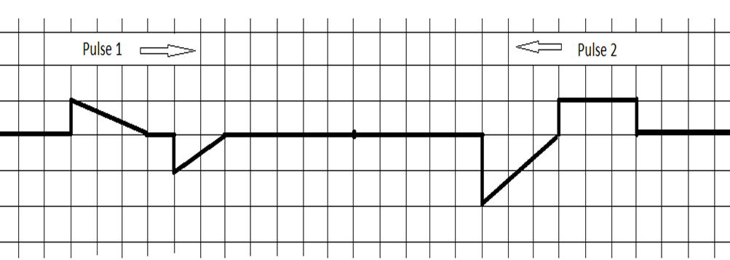
Example:
Use the principle of superposition to determine the resulting waveform when the waves in Figure interfere with each other.

Slide 8
Waves at Media Boundaries
Like all wave forms, sound waves can be either absorbed, transmitted, or reflected when they encounter a different type of matter.
Absorption: is the process whereby the sound’s energy is quickly being transformed into other forms of energy.
Transmission: is the passing of sound energy from one medium to another at the boundary.
Transmission causes a change in the speed / wavelength of a wave but the frequency stays the same.

Slide 9
Example:
A sound wave of wavelength 0.75 m is travelling in air at 0.0 ºC when it
hits a block of steel at the same temperature.
a) What is the frequency of the sound wave?
b) What is the wavelength of the sound wave in steel, if the speed of sound in steel is 5050 m/s;

Slide 10
Waves at Media Boundaries
Reflection: is the change in direction of a wavefront at an interface between two different media so that the wavefront returns into the medium from which it originated.
In reflection, the wavelength of the returning wave is not altered because there is no change in speed.

Slide 11
Free-End Reflections
Free-end reflection: a reflection that occurs at a media boundary where the second medium is less dense than the first medium; Reflection is happening without phase-shift.

Slide 12
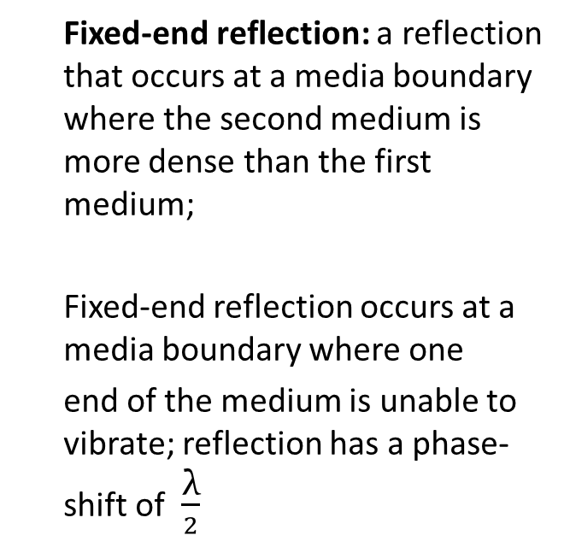
Fixed-End Reflections
Fixed-end reflection: a reflection that occurs at a media boundary where the second medium is more dense than the first medium;
Fixed-end reflection occurs at a media boundary where one
end of the medium is unable to vibrate; reflection has a phase-shift of $\frac{\text{λ}}{2}$

Slide 13
Media Boundaries: Amplitudes
Transmission: the motion of a wave through a medium, or motion of a wave from one medium to another medium.

Slide 14
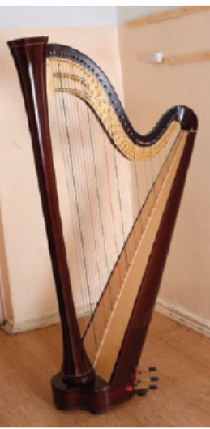
Standing Waves
Stationary interference pattern of successive nodes and antinodes created when waves travelling in opposite directions have the same frequency, amplitude and wavelength.

Slide 15
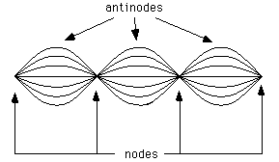
Node: is the location where the particles of the medium are
at rest due to destructive interference between crest and trough.
Antinode: is the location where the particles of the medium are moving with the greatest amplitude which is twice the amplitude of the original wave due to constructive interference between crest and crest or trough and trough.

Slide 16
Example:
A standing wave occurs in a duck pond when one duck repeatedly tries
to “jump” for food, as shown in Figure. The nodes are at every 38 cm.
(a)What wavelength of wave is our hungry duck producing?
(b) If the wave speed in the pond is 0.95 m/s, how often does the duck jump?

Slide 17
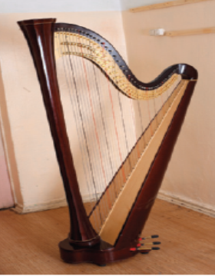
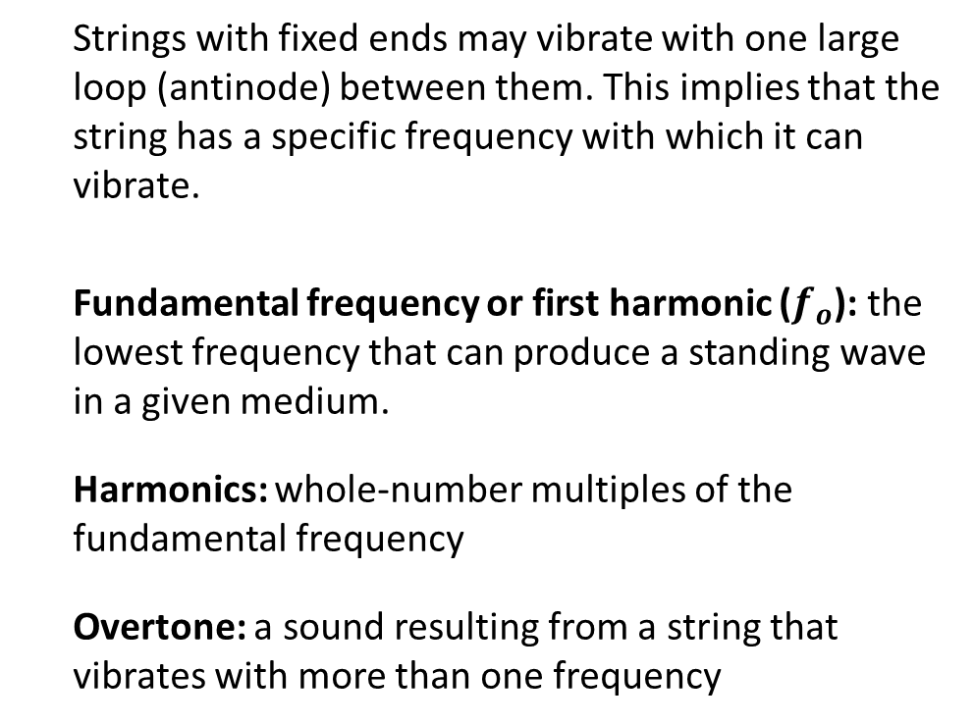
Standing Waves between Two Fixed Ends
Strings with fixed ends may vibrate with one large loop (antinode) between them. This implies that the string has a specific frequency with which it can vibrate.
Fundamental frequency or first harmonic ($f_{o}$): the lowest frequency that can produce a standing wave in a given medium.
Harmonics: whole-number multiples of the fundamental frequency
Overtone: a sound resulting from a string that vibrates with more than one frequency

Slide 18

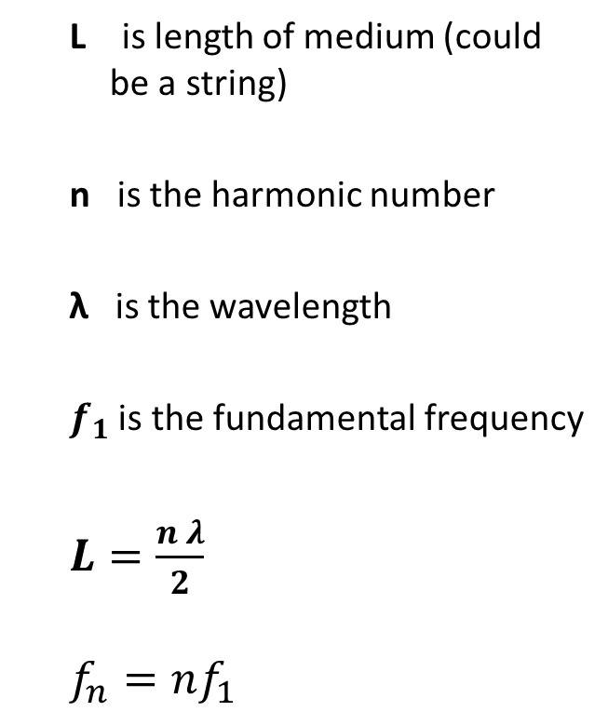



L is length of medium (could be a string)
n is the harmonic number
λ is the wavelength
$f_{1}$ is the fundamental frequency
$L=\frac{n λ}{2}$
$$f_{n}=nf_{1}$$
$f_{o}$ /$f_{1}$
$$f_{2}$$
$$f_{3}$$
$$f_{4}$$

Slide 19
Example:
Standing waves are produced in a string by a source with a frequency
of 10 Hz. The distance between the third and sixth node is 54 cm.
What is the wavelength of the interfering waves?
What is their speed?

Slide 20
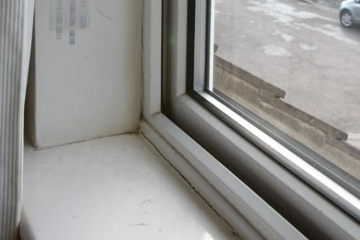
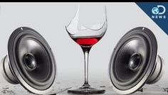
Mechanical Resonance
Mechanical resonance: the tendency of an object to respond to when the frequency of its oscillations matches the system's natural frequency of vibration
Examples of Mechanical Resonance:
A truck drives down your street and the windows of your house rattle.
Breaking a cup of glass using sound.
Breaking wine glass using resonance
Mechanical Resonance

Slide 21
Mechanical Resonance
Examples of Mechanical Resonance:
A tuning fork vibrating at 250 Hz causes another tuning fork with the same frequency to also vibrate.
Tuning Forks

Slide 22
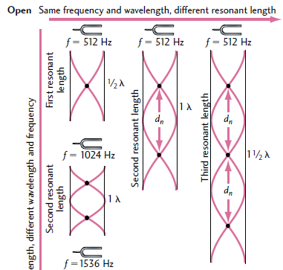
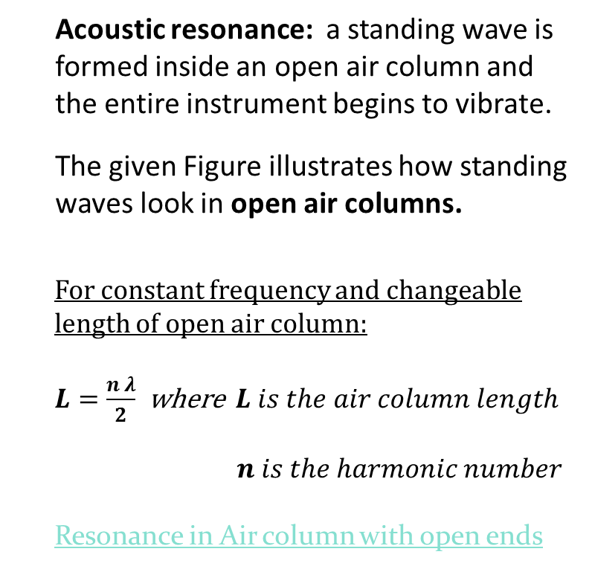
Resonance and Wind Musical Instruments
Acoustic resonance: a standing wave is formed inside an open air column and the entire instrument begins to vibrate.
The given Figure illustrates how standing waves look in open air columns.
For constant frequency and changeable length of open air column:
$L=\frac{n λ}{2}$ where $L is the air column length$
$n is the harmonic number$
Resonance in Air column with open ends

Slide 23
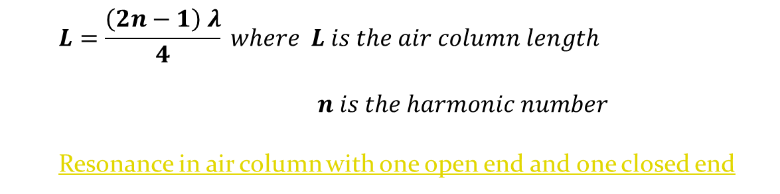
Resonance and Wind Musical Instruments
Acoustic resonance: a standing wave is formed inside an open-closed air column and the entire instrument begins to vibrate.
The given Figure illustrates how standing waves look in open-closed air columns.
For constant frequency and changeable length of open air column:
$$L=\frac{\left(2n−1\right) λ}{4} where L is the air column length$$
$n is the harmonic number$
Resonance in air column with one open end and one closed end

Slide 24
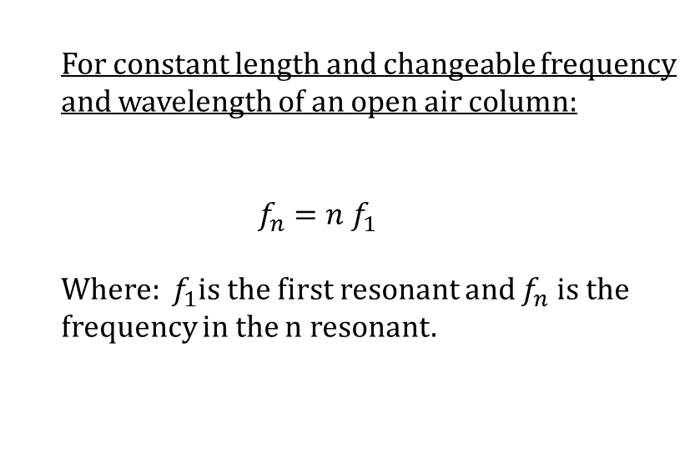
Resonance and Wind Musical Instruments
For constant length and changeable frequency and wavelength of an open air column:
$$f_{n}=n f_{1}$$
Where: $f_{1}$is the first resonant and $f_{n}$ is the frequency in the n resonant.
1st harmonic
2nd harmonic
3rd harmonic

Slide 25
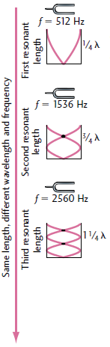
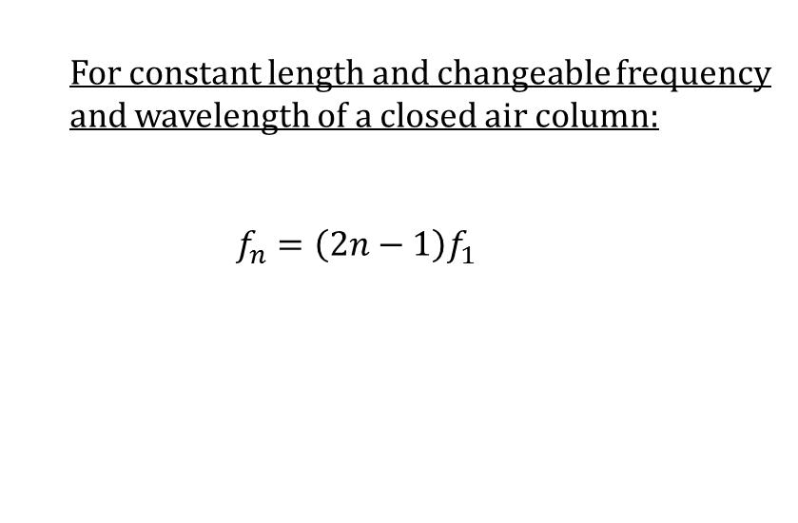
Resonance and Wind Musical Instruments
For constant length and changeable frequency and wavelength of a closed air column:
$$f_{n}=\left(2n−1\right)f_{1}$$

Slide 26
Example:
The sixth harmonic of a 65 cm guitar string is heard. If the speed of sound in the string is 206 m/s, what is the frequency of the standing wave?

Slide 27
Example:
The speed of sound in an air column with a fixed end and a free end is 350 m/s. The frequency of the wave is 200.0 Hz. What length of air column to produce a standing wave with the first harmonic?

Slide 28
Example:
Standing waves are produced in a string by a source with a frequency
of 10 Hz. The distance between the third and sixth node is 54 cm.
What is the wavelength of the interfering waves?
What is their speed?

Slide 29
Example:
An air column that is open at both ends is 1.50 m long. A specific frequency is heard resonating from the column. What is the longest wavelength and its associated frequency that could be responsible for this resonance? The speed of sound in air is 345 m/s.

Slide 30
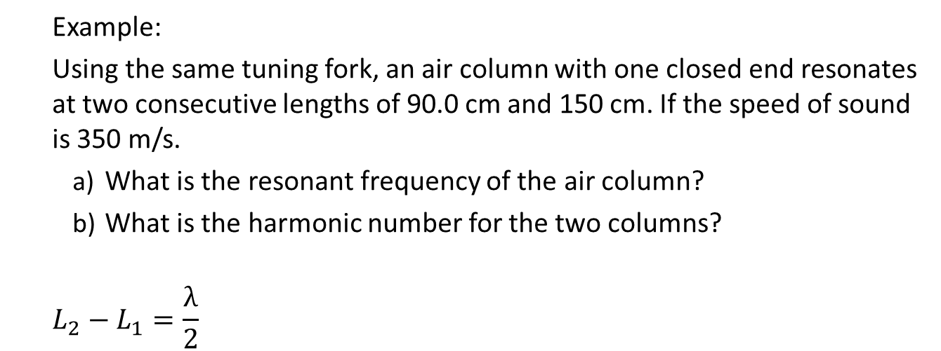
Example:
Using the same tuning fork, an air column with one closed end resonates at two consecutive lengths of 90.0 cm and 150 cm. If the speed of sound is 350 m/s.
What is the resonant frequency of the air column?
What is the harmonic number for the two columns?
$$L_{2}−L_{1}=\frac{λ}{2}$$

Slide 31
Acoustic Resonance and Musical Instruments
Music sound: that originates from a combination of musical notes that originate from a source that vibrates in a uniform manner with one or more constant frequencies.
Noise sound: that originates from a source that vibrates in a random manner.
The wind instruments: are elaborate air columns in which a standing wave is formed.

Slide 32
Resonance and Wind Musical Instruments
Wind instruments can have the lengths of their air columns adjusted so they are tuned to different fundamental frequencies.
Woodwind instruments, like the clarinet, the oboe, and the saxophone, vary their air column length by uncovering holes in the body

Slide 33
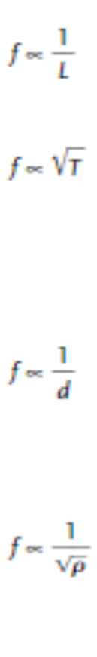
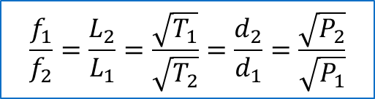
Stringed Instruments
$$\frac{f_{1}}{f_{2}}=\frac{L_{2}}{L_{1}}=\frac{\sqrt{T_{1}}}{\sqrt{T_{2}}}=\frac{d_{2}}{d_{1}}=\frac{\sqrt{P_{2}}}{\sqrt{P_{1}}}$$

Slide 34
Example:
A guitar string of length 0.80 m has a frequency of 375 Hz. When it is shortened to 0.60 m, what is its new frequency?

Slide 35
Example:
A string has an original tension of 150 N. What new tension must be applied to the string to have it vibrate with a frequency exactly twice that of the original?

Slide 36
Beats
The individual sound waves are heard by an observer at some location within the medium.
The combined wave has an amplitude (blue dashed line) that varies in a regular manner.

Slide 37
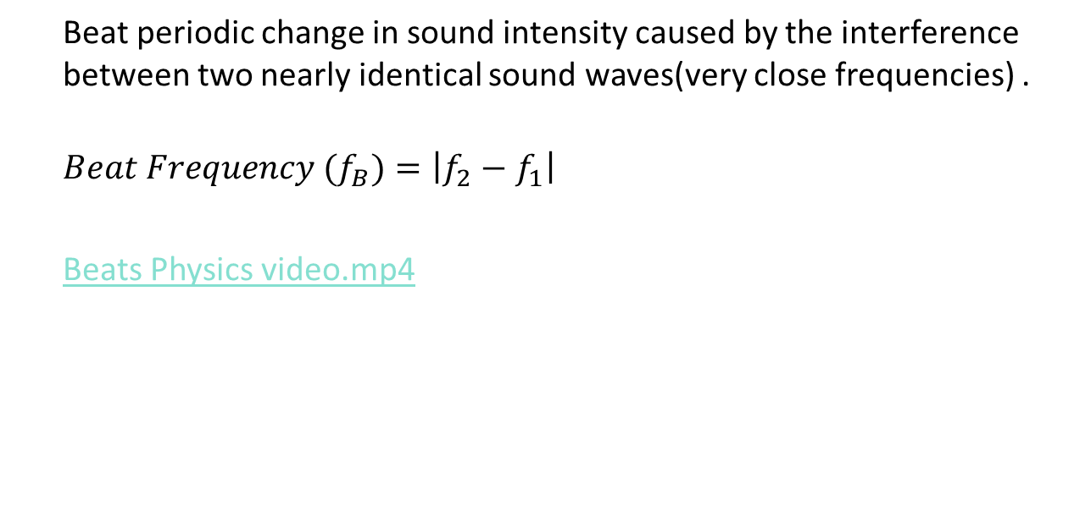
Beats
Beat periodic change in sound intensity caused by the interference between two nearly identical sound waves(very close frequencies) .
$$Beat Frequency (f_{B})=\left|f_{2}−f_{1}\right|$$
Beats Physics video.mp4

Slide 38
Example:
A piano tuner strikes a 256 Hz (middle C) tuning fork and middle C on a piano. She hears 20 beats in 5.0 s. What are the possible frequencies of the out-of-tune note?

Slide 39
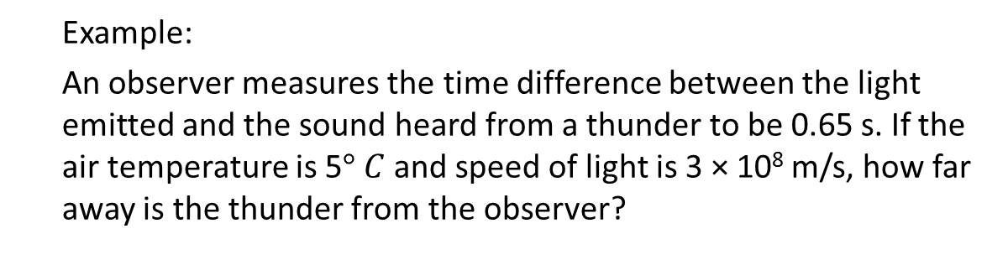
Example:
An observer measures the time difference between the light emitted and the sound heard from a thunder to be 0.65 s. If the air temperature is 5$° C$ and speed of light is 3 × 10⁸ m/s, how far away is the thunder from the observer?

